Slide 1
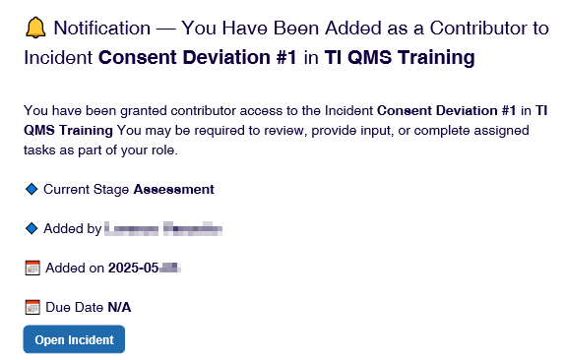
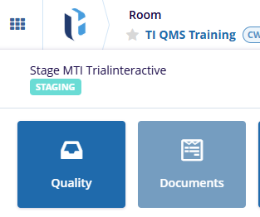
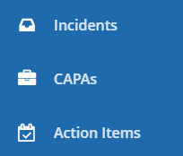
Admin
Manager
Editor
Reader
QMS
eISF
TI QMS supports different types of Record related to Quality Events.
‘Record’ may refer to an Incident, CAPA, or Action Item.
1
Contributors to various steps of a record workflow will be emailed when their input is required.
You may click on a Open [Record] link in such emails to be brought to the record directly. If doing so, skip to step 5 in this guide.
1
2
You may also identify record to contribute to yourself.
Enter your QMS-enabled room and, via the waffle or the module selector, navigate to the Quality module (the name may vary).
2
3
3
Select the option appropriate to the Record of interest, from the navigation sidebar.
The example in this Job Aid is an Incident.

Slide 2

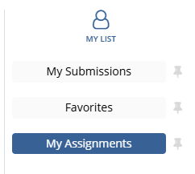


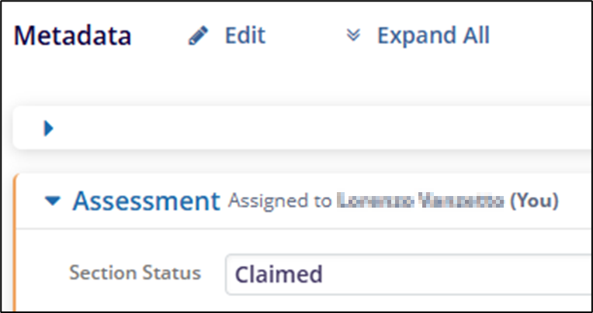
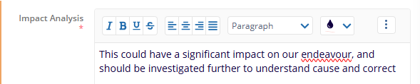

3
Click on the View Selector and change to the My Assignments view.
This will help you locate the intended record.
3
4
Click on the Inbox Icon for a record
to display it in a full-page view –
or click on the incident name
if you prefer to work in the side panel.
4
5
Click on the Start [Stage] button to claim the record.
5
6
6
Provide the information requested for the record. In this example, an assessment is requested.
Click on the Edit button next to Metadata…
7
7
.. And write/paste your contribution in the text box(es). Fields with an asterisk are required.
Text boxes like these support rich text, including pictures and Tables.

Slide 3

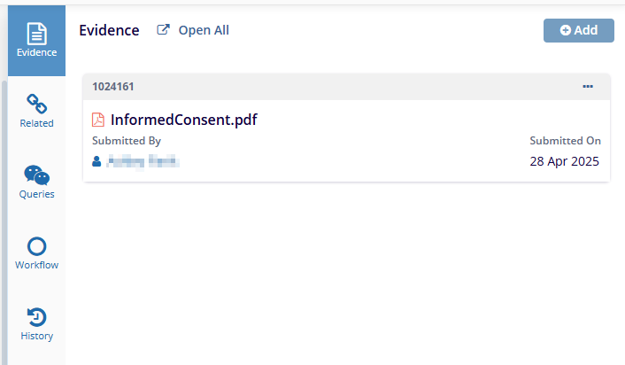
8
Click on Save at the bottom of the page to store your changes.
8
9
9
Use the Side Panel to review or interact with supporting information, including provided Evidence, Queries, Related Records.
10
Use the buttons above the side panel to move the record through the workflow.
Click on Approve for Investigation to send this Incident to its next phase and contributor.
10

