Slide 1

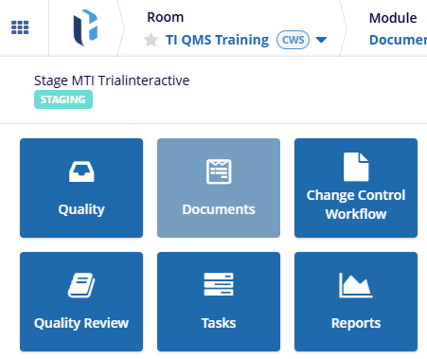
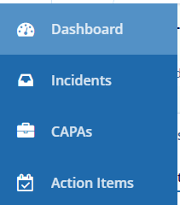
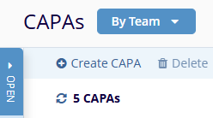
Admin
Manager
Editor
Reader
QMS
eISF
Due to the flexible configuration of TI QMS, variations from the example shown should be expected . For example, different datafields may be required or displayed.
1
Enter a QMS-Enabled Collaborate room. Via the waffle or the module selector, navigate to the Quality module (the name may vary).
1
2
Select the option for CAPAs from the navigation sidebar.
2
3
Click on Create CAPA.
3

Slide 2

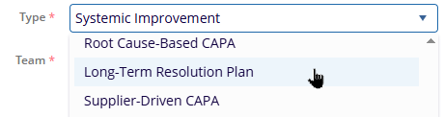
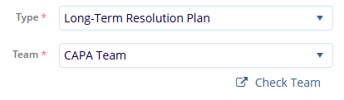
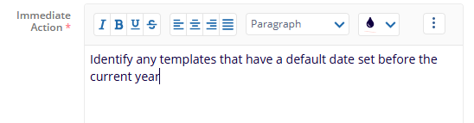
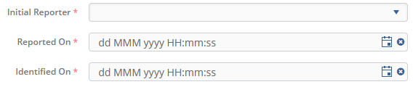
4
4
Give a Title to the CAPA.
Select the Type of CAPA from the Type dropdown.
This will also auto-select the Team assigned to that type, if any.
5
5
6
The Check Team button allows you to review what users are members of the selected Team.
6
Populate the ‘Action’ text fields.
Required fields are marked with a red asterisk.
Text boxes like these support rich text, including pictures and Tables.
7
7
8
8
Set the Reporting fields.
You can use the calendar buttons
to select day and time.

Slide 3
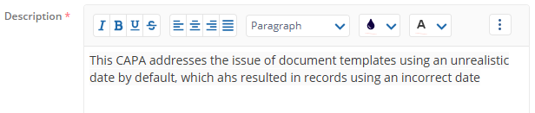
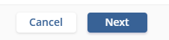



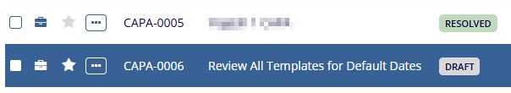
9
Complete any other fields as required.
9
10
Click on Next to move to the second part of CAPA setup, which is adding evidence.
10
11
Choose how you’ll add evidence.
You may Upload files, Search for existing content in the current room, or type/paste URLs.
11
12
Complete Adding Evidence as chosen, then click Create to generate a Draft CAPA, or Create & Submit to send the record to the
first contributor.
12
13
Once Created, a CAPA can be found in the CAPAs browser with its current status.
13

Slide 4

14
Click on the Inbox Icon to display a full page view of the CAPA –
or click on the record name to display details in the side panel.
14
15
Only if you chose Create in step 12, the CAPA can be advanced from Draft to active status by clicking the Submit for button above the side panel.
15

