Slide 1
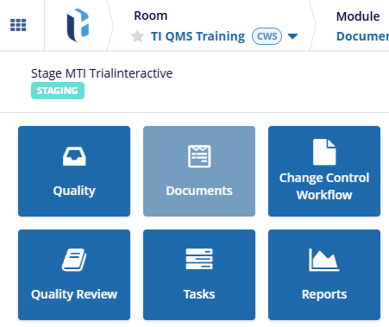
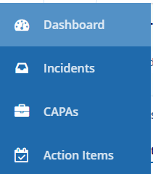
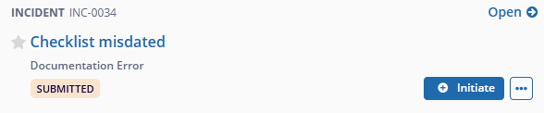
Admin
Manager
Editor
Reader
QMS
eISF
1
Enter a QMS-Enabled Collaborate room. Via the waffle or the module selector, navigate to the Quality module (the name may vary).
1
2
2
Enter one of the Records lists from the navigation sidebar.
3
Action Items are created as follow ups to Incidents or CAPAs. Select a record and click the Initiate button displayed above the side panel.
3

Slide 2
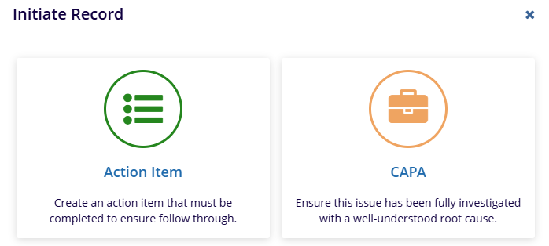

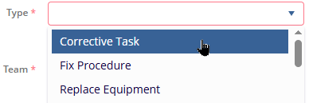
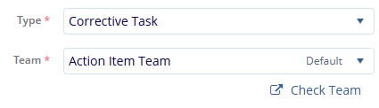
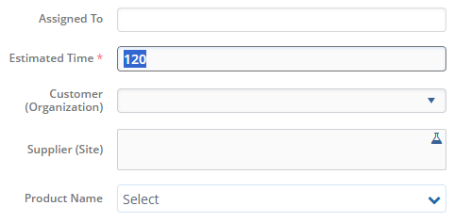
Click on the option for Action Item.
4
4
5
5
Give a Title to the Action Item.
6
6
Select the Type of Item from the Type dropdown.
This will also auto-select the Team assigned to that type, if any.
7
The Check Team button allows you to review what users are members of the selected Team.
7
8
Set the Estimated Time field (in this example, value is in minutes). Also change or define the other fields as required.
Available fields may vary due to configuration differences.
8

Slide 3
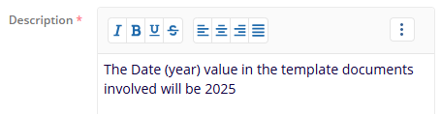
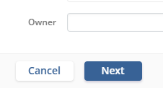



9
9
Write a Description and populate any other text fields (these may vary).
10
Click on Next to move to the second part of Incident setup, which is adding evidence.
10
11
Choose how you’ll add evidence.
You may Upload files, Search for existing content in the current room, or type/paste URLs.
11
12
Complete Adding Evidence as chosen, then click Create to generate a Draft, or Create & Submit to send the Action Item to the
first contributor.
12
13
Once Created, item can be found in the Action Items list with its current status.
13

Slide 4

14
Only if you chose Create in step 12, the Action Item can be advanced from Draft to active status by clicking the Submit for button above the side panel.
14

